Slide 1
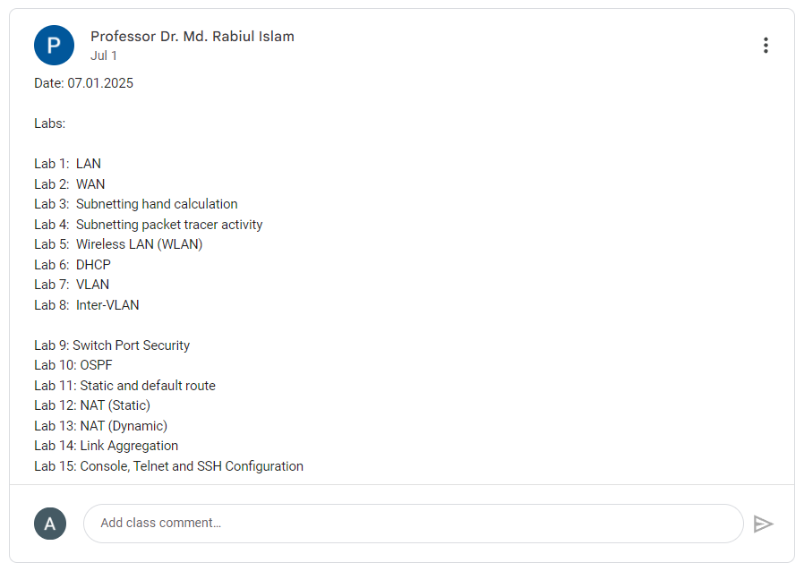

Slide 2
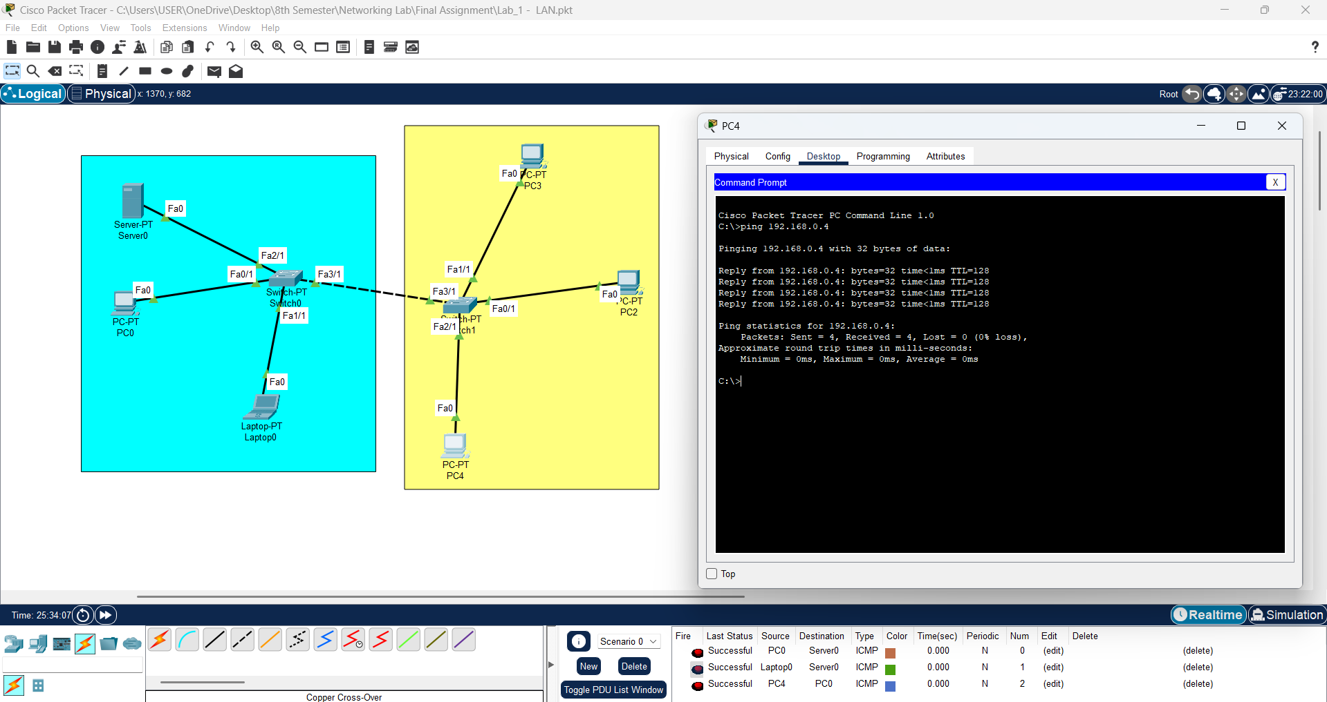
Lab 1 - LAN

Slide 3
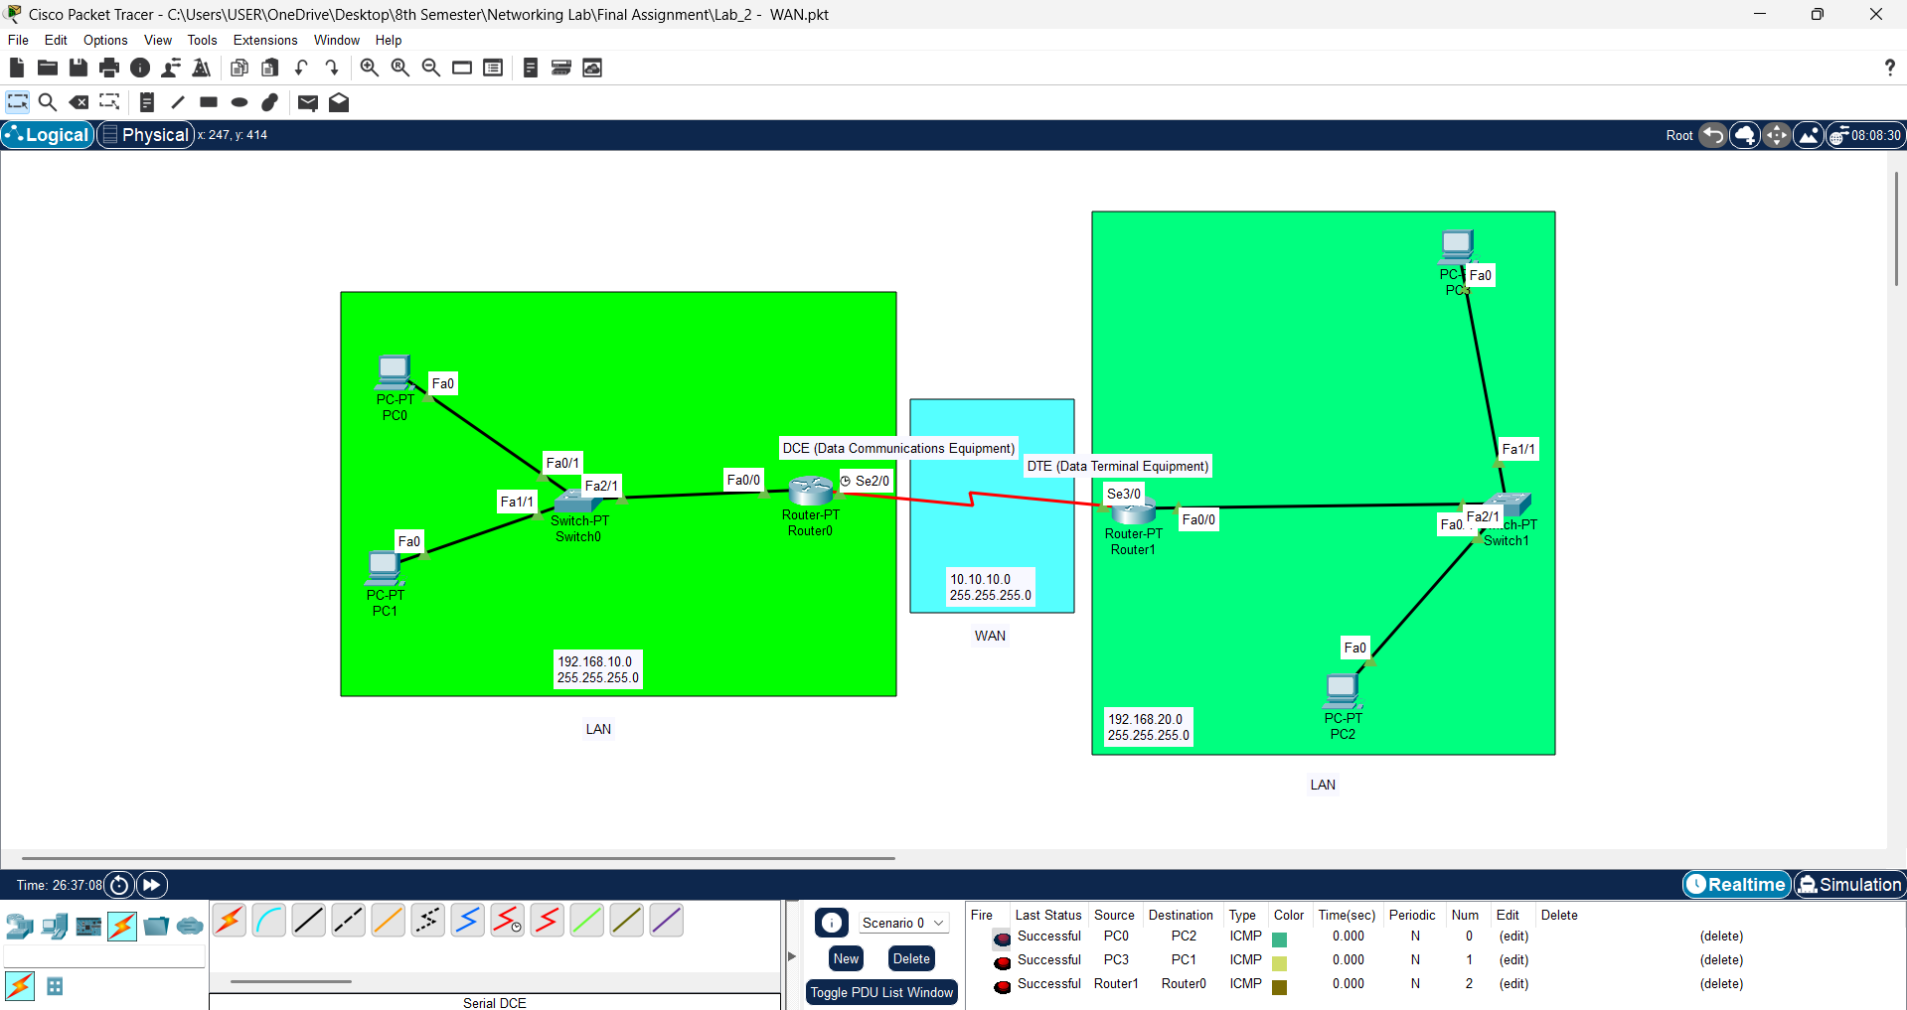
Lab 2 - WAN

Slide 4
Router0
Router1
Router Configuration
Router Configuration
Router>enable
Router#configure terminal
Router(config)#interface fa0/0
Router(config-if)#ip address 192.168.10.1 255.255.255.0
Router(config-if)#no shutdown
Router>enable
Router#configure terminal
Router(config)#interface fa0/0
Router(config-if)#ip address 192.168.20.1 255.255.255.0
Router(config-if)#no shutdown
Router Configuration (Serial)
Router Configuration (Serial)
Router>enable
Router#configure terminal
Router(config)#interface se2/0
Router(config-if)#ip address 10.10.10.1 255.255.255.0
Router(config-if)#clock rate 64000
Router(config-if)#no shutdown
Router>enable
Router#configure terminal
Router(config)#interface se3/0
Router(config-if)#ip address 10.10.10.2 255.255.255.0
Router(config-if)#no shutdown
Serial DCE
IP Route Configuration (Router0)
IP Route Configuration (Router1)
Router>enable
Router#configure terminal
Router(config)#ip route 192.168.20.0 255.255.255.0 se2/0
Router>enable
Router#configure terminal
Router(config)#ip route 192.168.10.0 255.255.255.0 se3/0
IP Route
Router>enable
Router#show ip route

Slide 5
Lab 3 - Subnetting hand calculation

